Slide 1
Graduate Awards Automation Application Process
Office of Graduate Student Assistantships and Fellowships
George Washington University
Rice Hall 302

Slide 2
Graduate Automated Awards Application
The Graduate Automated Awards Application is used to award graduate students assistantships, stipend fellowship and tuition fellowship. It generates award letters and creates a record of the award in Banner.

Slide 3
Graduate Automated Awards Application
As of December 12, 2014, the Automated Awards Application went live. This allows users to initiate the award process and send award letters online. Please note that all units at GWU awarding graduate students from University funds should use the Automated Awards Application.
Awards made from sponsored project funds should NOT use this application for their awards (tuition fellowships, stipend fellowships or graduate research assistantships) until an announcement is made. The application should be available to research-related staff May 2015. See Appendix A for Manual Award Instruction.

Slide 4
Graduate Automated Awards Application-Getting Access
Prior to Accessing the Graduate Award Automation Process
Banner access and Banner Workflow access are required to use the Graduate Award Automation Application as an initiator or approver. Complete the form below with the help of your School/Department Banner Liaison.
Banner Access To request Banner access go to the http://saig.gwu.edu/forms link
Under Security Access Forms, download the Banner Access Form. If you do not already have access to Banner Student, check with your Banner Liaison to determine what profile you will need.
For Banner Workflow access, the profile you need to request on the STUDENT PROFILES page is PWSDRST(Owner/Approver Geri Rypkema rypkema@gwu.edu) . In the Notes/Special Instruction section at the bottom of the page, indicate your role: Initiator or Approver. Once the form has been completed and all signatures obtained, email the form to Banner Security(HRIS) sysuid@gwu.edu
You will receive an email notice once your access has been granted.
Banner Profile for Graduate Awards Reports
A new Banner profile *GSAF01 was created for the Graduate Award Reports. These reports are TZRGRAW and TZRGADT and are run in Banner. Only those staff who are managing the awards require this access. To run these reports you, need to complete a Banner Access form or add to the access forms above to request access to the *GSAF01 Profile (Owner/Approver Geri Rypkema rypkema@gwu.edu). When signed, the form will be sent to Banner Security sysuid@gwu.edu.
How to access Banner Workflow
Banner workflow can be accessed via the Workflow Virtual Browser. Instructions on how to get the Virtual Browser are included in the Online Training.
Online Training for the Graduate Automated Awards Process
Click on this link to access online training
Automated Award Training

Slide 5
Graduate Automated Awards Application-Getting Started
From the main menu, click My Processes under User Profile
Click to start workflow

Slide 6
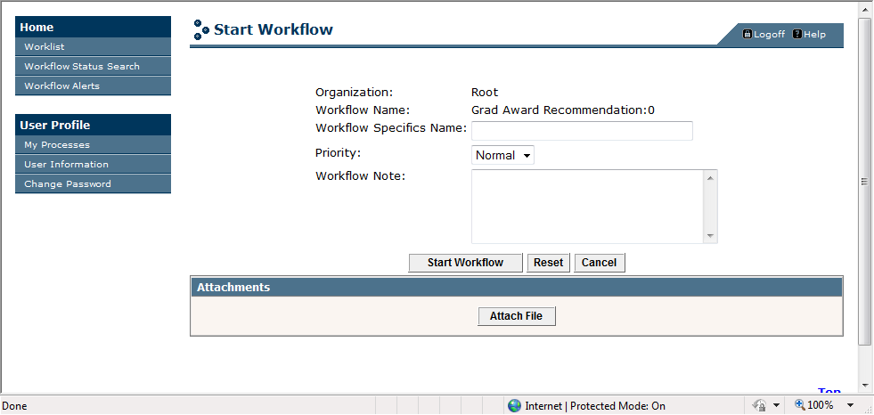
Graduate Automated Awards Application-Getting Started
Initiator will create name/GWid identifier to locate award

Slide 7
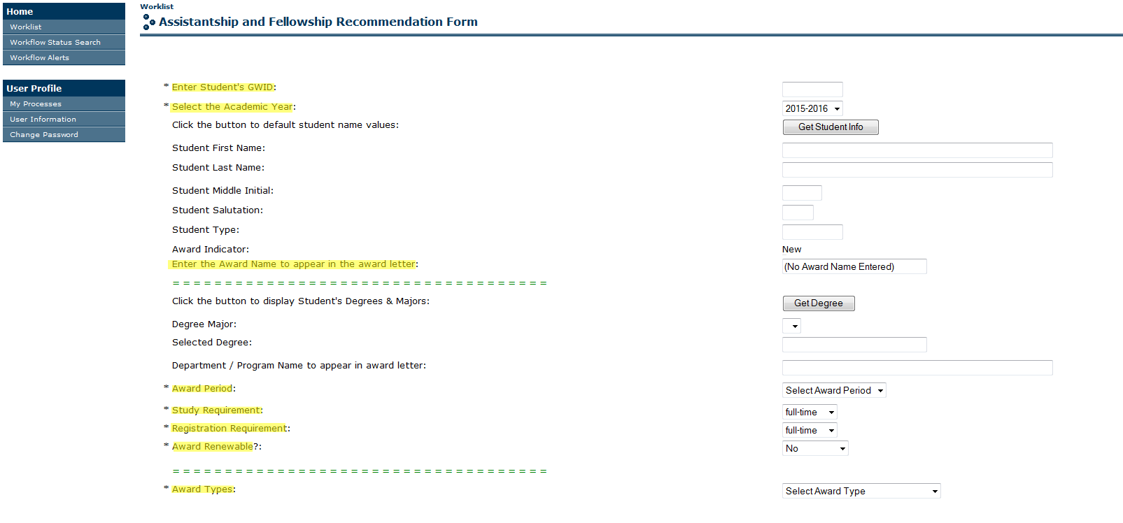
Graduate Award Automation-
Type award formal name
Type formal award name

Slide 8
Graduate Award Automation- Banner Reports
There are two reports for tracking the awards for the Graduate Award Automation Process which can be run in Banner:
TZRGRAW – Graduate Awards Report
TZRGRAW will report graduate award information based on the filter criteria (parameters) entered before running the report. Here you can find pertinent details of the award, its status in the queue and whether the award has been accepted or declined.
TZRGADT – Graduate Award Detail Report
TZRGRAW will report graduate award information based on the filter criteria (parameters) entered before running the report.

Slide 9
Graduate Awards Report-TZRGRAW
Parameter Number | Parameter Name | Optional/ Required | Single/ Multiple | Help | Notes
01 | Academic Year | Required | Multiple | Enter Academic Year, e.g. 2013-2014 | If % is entered then all the awards regardless of the academic year will be selected Enter 2014-15, 2015-16 or you will get an error
02 | College Code | Optional | Single | Enter the Department Code | If you hit the Values button then the list of colleges will be displayed you can pick a college code from the list.
03 | Degree Code | Optional | Single | Enter Degree | If you hit the Values button then the list of degrees will be displayed you can pick a degree code from the list.
04 | Major Code | Optional | Single | Enter Major code | If you hit the Values button then the list of major will be displayed you can pick a major code from the list.
05 | Payment Start Date | Optional | Single | Enter Payment Start Date | This start date will be used to get the awards between the payment start date and payment end date
06 | Payment End Date | Optional | Single | Enter Payment End Date | This end date will be used to get the awards between the payment start date and payment end date

Slide 10
07 | Funding Source | Optional | Single | Enter Funding Source | If you hit the Values button you will be able to pick one of the following funding sources 1) School Graduate Student Support 2) R Fund 3) Endowment 4) Graduate Student Assistantship and Fellowship 5) Sponsored Project 6) Other
08 | Banner Index Code | Optional | Single | Enter Banner Index code | Enter a valid Banner index
09 | Project | Optional | Single | Enter Project | The Banner Index OR the PTA can be entered. If parameter Banner Index code parameter 08 is entered then parameters 09, 10 and 11 should be not entered. If the Project, parameter 09 is entered then Award parameter 10 and Task parameter 11 must be entered
10 | Task | Optional | Single | Enter Task | If the Project, parameter 09 is entered then Award parameter 10 and Task parameter 11 must be entered
11 | Award | Optional | Single | Enter Award | If the Project, parameter 09 is entered then Award parameter 10 and Task parameter 11 must be entered
12 | GWID | Optional | Single | Enter Student’s GWID

Slide 11
Sample Report-TZRGRAW

Slide 12
TZRGADT-Graduate Award Detail Report
Parameter Number | Parameter Name | Optional/ Required | Single/ Multiple | Help | Notes
01 | Student GWID | Required | Single |  | Enter the Student’s GWID
02 | Academic Year | Required | Single | Please provide the parm value as ex. 1314 | Enter the Academic Year as 1314 or 1415
03 | Award Sequence Number | Required | Single | This is award sequence number | Run the TZRGRAW – Graduate Award Report for the student the award sequence number is listed in this report
Types of files generated by the report
userid¬_tzrgadt_jobnumber.lis example:issds2_tzrgadt_6476761.lis

Slide 13
Sample Report-TZRGADT

Slide 14
Appendix A- Manual GA Award Process
Awarding Entity (Department or Principal Investigator (PI))
Selects a candidate who meets relevant merit eligibility criteria.
Completes the Assistantship and Fellowship Recommendation Form.
Forwards the Assistantship and Fellowship Recommendation Form to the Department Chair.
Department Chair
Reviews the award information and verifies that the recipient is a student, current or incoming.
Signs the Assistantship and Fellowship Recommendation Form.
Forwards the Form to the School Fellowship Coordinator (SFC).
School Fellowship Coordinator (SFC)
Reviews files to determine whether recipient is receiving or has been offered any other awards.
For current students, reviews transcript to ensure that there are no incompletes or unacceptable grades.
Signs the Assistantship and Fellowship Recommendation Form.

Slide 15
Appendix A- Manual GA Award Process
School Fellowship Coordinator (SFC) cont’d
A. If non-sponsored research-funded, (SFC) or designee sends award package to the student, the award package must include the following:
Graduate Assistantship Award Letter - Graduate Assistantship Model Letter
Acceptance Form - Graduate Assistantship Acceptance Form
Graduate Assistantship Requirements - Graduate Assistantship Requirements
Tax Information - Tax Implications and Reporting Requirements of Payments to International Students OR
Tax Implications and Reporting Requirements of Payments to U.S. Citizens or Resident Aliens
B. If sponsored research-funded, steps 7, 8 and 9 above are followed, in lieu of step 10, forwards the signed form to the appropriate research related staff member connected to the grant. (No GAs on grants)
Research Related Staff Member
Reviews information to ensure that the payment is allowable on the grant.
Checks to make sure funds are available.
Checks to ensure the award is within the date parameters of the grant.
Checks to ensure that full F&A is recovered if the “yes” box on the form is checked.

Slide 16
Appendix A- Manual GRA Award Process
PI/Initiator
Sends award letter to student. The award package must include the following:
Graduate Research Assistantship Award Letter - Graduate Research Assistantship Model Letter
Acceptance Form - Graduate Assistantship Acceptance Form
Graduate Research Assistantship Requirements - Graduate Research Assistantship Requirements
Tax Information - Tax Implications and Reporting Requirements of Payments to International Students OR
Tax Implications and Reporting Requirements of Payments to U.S. Citizens or Resident Aliens
Both the School Fellowship Coordinator (SFC) and the PI/Initiator forwards a copy of the returned, signed Graduate Assistantship Acceptance Form to the Department Chair and the Office of Graduate Student Assistantships and Fellowships.
If the award is declined, the Award Processes start over.
If the award is accepted, the Hire Processes (Hire a GA/GRA Online) can begin.

Slide 17
Appendix B- Manual Fellowships Award
Awarding Entity (Department or Principal Investigator (PI))
Selects a candidate who meets relevant merit eligibility criteria.
Completes the Assistantship and Fellowship Recommendation Form.
Completes the Payment Characterization Checklist, if a stipend is included.
Forwards the Assistantship and Fellowship Recommendation Form and Payment Characterization Checklist, if applicable, to the Department Chair.
Department Chair
Reviews the award information and verifies that the recipient is a student, current or incoming.
Signs the Assistantship and Fellowship Recommendation Form and Payment Characterization Checklist.
Forwards the Form(s) to the School Fellowship Coordinator (SFC).
School Fellowship Coordinator (SFC)
Reviews files to determine whether recipient is receiving or has been offered any other awards.
Reviews the award if a stipend is part of the award to ensure that no services are required.
For a current student, reviews transcript to ensure that there are no incompletes or unacceptable grades.

Slide 18
Appendix B- Manual Award Fellowships
School Fellowship Coordinator (SFC) cont’d
Signs the Assistantship and Fellowship Recommendation Form and Payment Characterization Checklist.
A. If non-sponsored research-funded, (SFC) or designee sends award package to the student, the award package must include the following:
Fellowship Award Letter - Fellowship Award Letter
Fellowship Acceptance Form - Fellowship Acceptance Form
Fellowship Requirements -
Fellowship Requirements for Stipend and Tuition Award or Stipend Only
Fellowship Requirements for Tuition Award Only
Tax Information - Tax Implications and Reporting Requirements of Payments to International Students OR
Tax Implications and Reporting Requirements of Payments to U.S. Citizens or Resident Aliens
B. If sponsored research-funded, steps 8 through 11 above are followed. In lieu of step 12, forwards the signed form to the appropriate research staff member connected to the grant.
Forwards a copy of the returned, signed Fellowship Acceptance Form to the Department Chair.
If the award is declined, the Award Processes start over.
If the award is accepted, the Payment Processes begin.

Slide 19
Appendix B- Manual Fellowships Award
Research Staff Member
Reviews information to ensure that the payment is allowable on the grant.
Checks to make sure funds are available.
Checks to ensure the award is within the date parameters of the grant.
If the award is for a Fellowship stipend, ensures that the grant is a training grant that allows this type of payment.
Signs the Assistantship and Fellowship Form.
Returns to the Principal Investigator (PI).
PI/Initiator/Department
Sends award package to student.

